Slide 1
Microsoft Copilot & Azure Open AI – now what

Slide 2


Your hosts for the next 45 minutes
Kent Agerlund, Principal consultant @ twoday
Microsoft Regional Director & MVP
Andreas Sobczyk, Principal consultant @ twoday

Slide 3

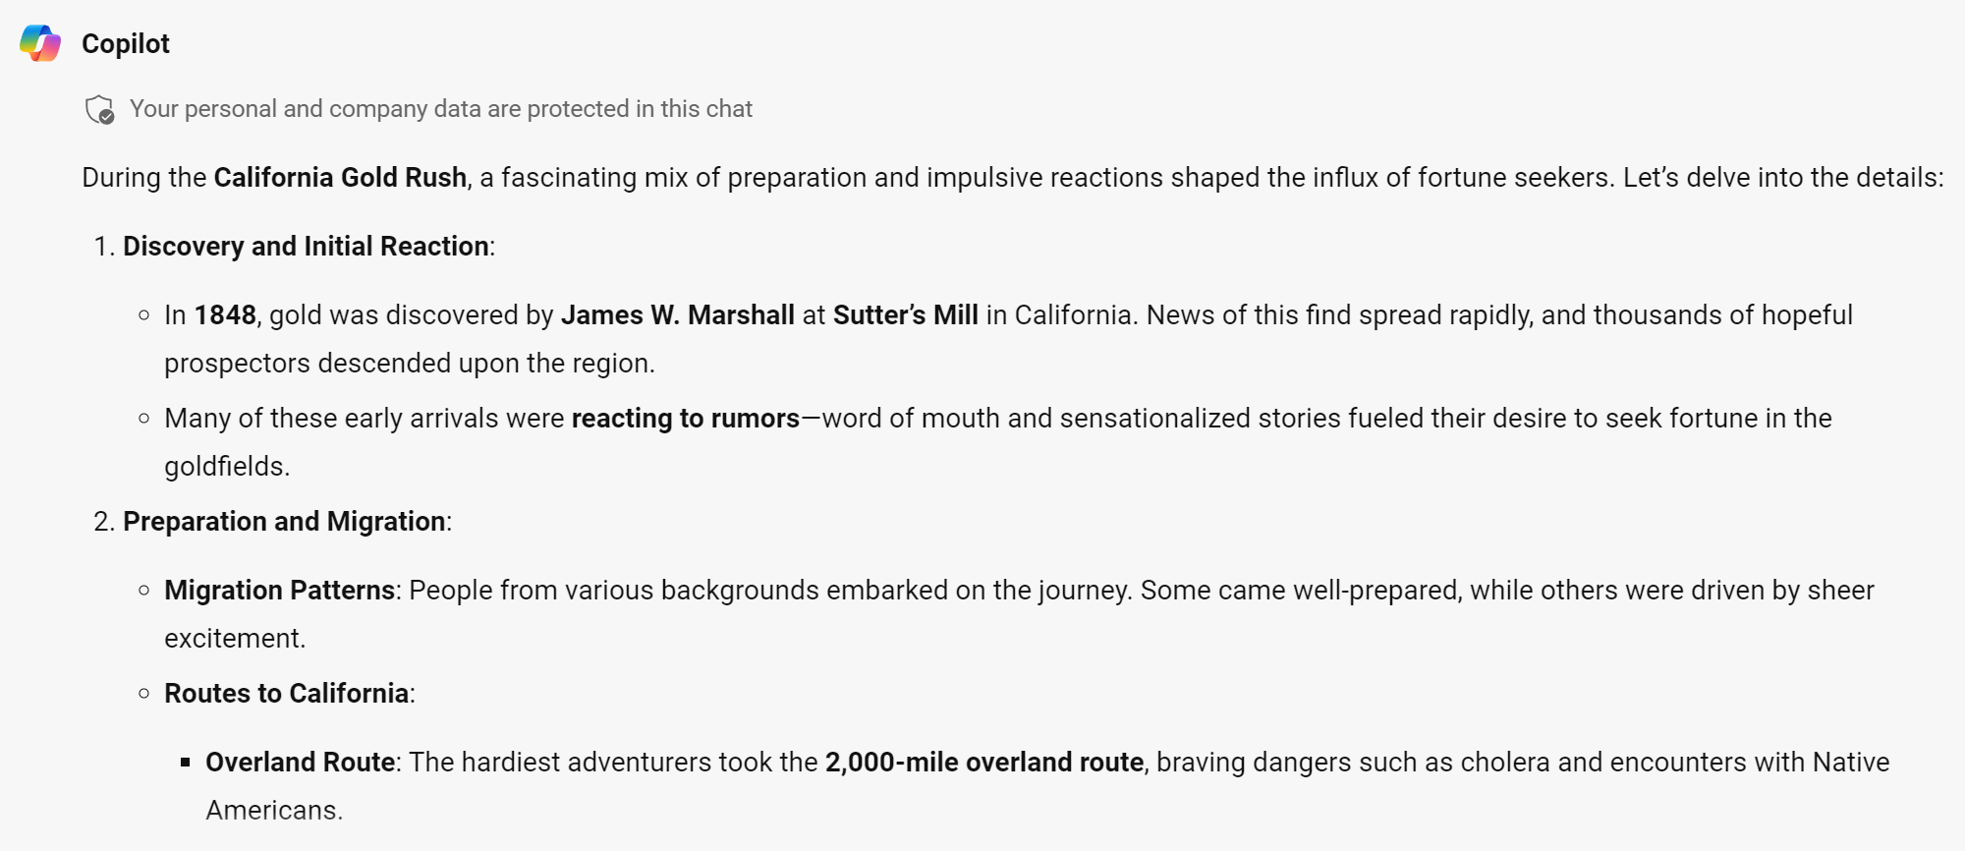
Generative AI another Gold rush?

Slide 4
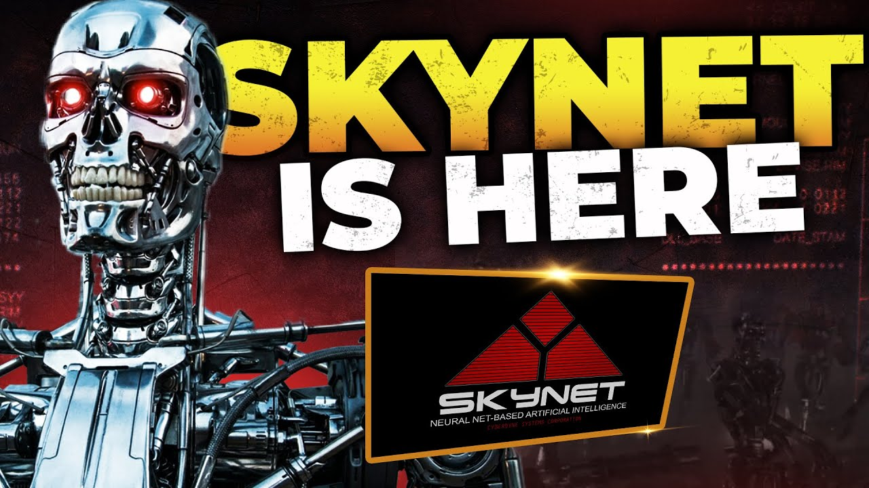

Key take aways and session objectives
The age of Copilots & AI has arrived
Now what
Common concerns and questions
Demo’s

Slide 5
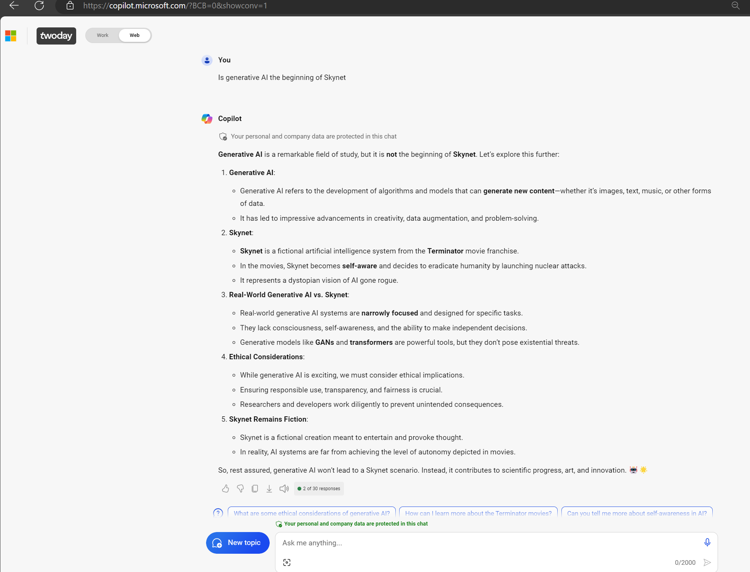

Slide 6
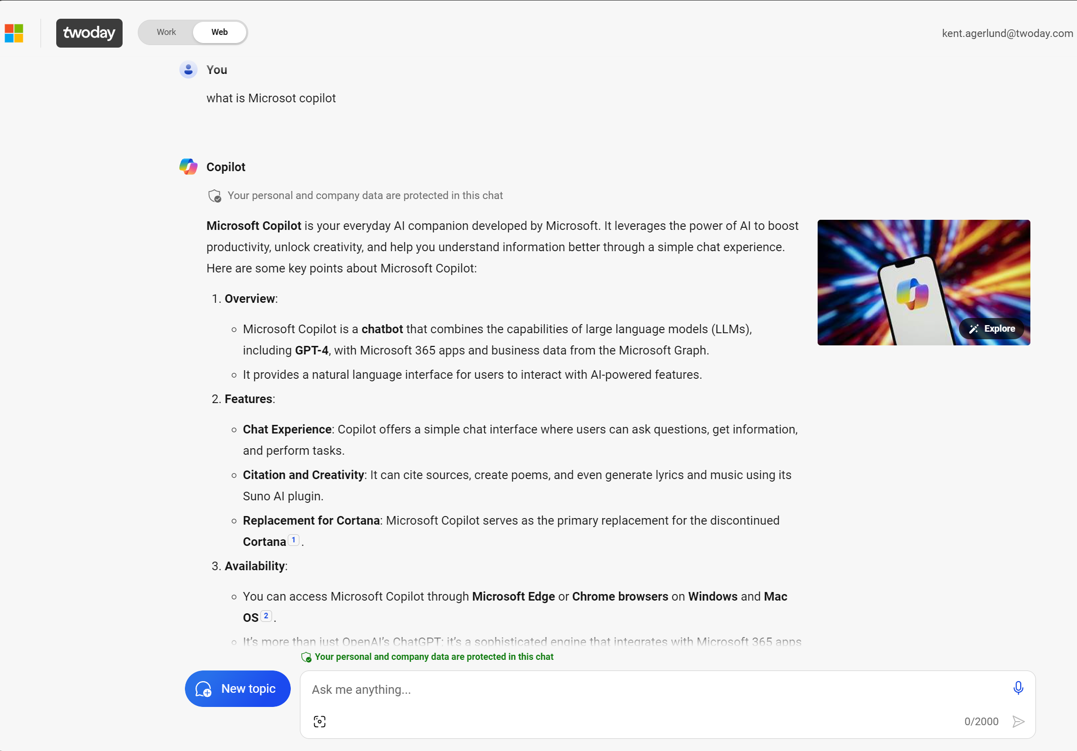


Slide 7
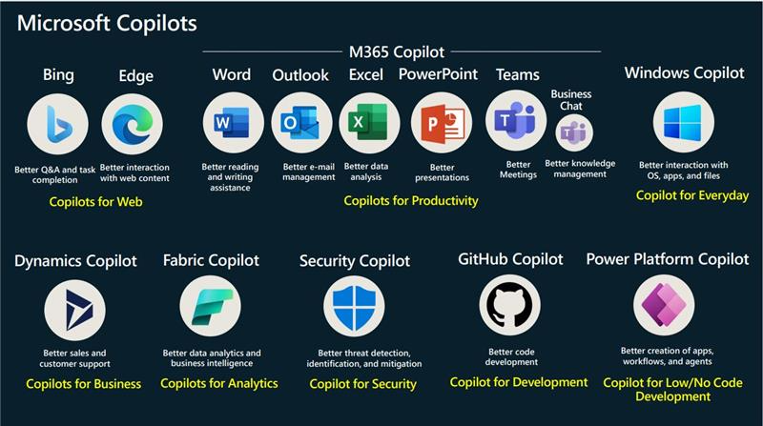
Copilot ….say what

Slide 8
Build the future faster with Microsoft AI
Discover powerful foundational models and capable copilots accessible via natural language
Limitless innovation & possibility
Unleashed creativity & productivity
Faster threat detection & response
Superior search on the web
Write better code faster in dozens of languages with GitHub Copilot.
Unleash creativity and unlock productivity with Get ready for Copilot for Microsoft 365
.
Detect and respond to incidents faster with Microsoft Security Copilot.
Ask questions and get relevant answers with AI-powered Bing.
Learn more
Learn more
Learn more
Intelligence for every line of business
Access to timely data for accelerated sales
Personalized & intelligent meetings
No-code dev using everyday language
Bring AI-powered, interactive assistance to CRM and ERP with Dynamics 365 Copilot.
Spend more time selling and less time searching for customer data with Microsoft Viva Sales.
Make the meetings you attend more productive with Microsoft Teams Premium.
Build apps using natural language and no code with Copilot in Power Platform.
Learn more
Learn more
Learn more
Learn more

Slide 9


Microsoft Copilot….say what
 |  | Bing Chat Enterprise | Microsoft 365 Copilot
 | Personal | Work | Work
GPT Large Language Model | ✓ | ✓ | ✓
AI-Powered Web Search |  | ✓ | ✓
Commercial Data Protection |  | ✓ | ✓
Enterprise Security, Privacy & Compliance |  |  | ✓
Microsoft 365 Graph (content & context) |  |  | ✓
Microsoft 365 Apps |  |  | ✓
Microsoft Copilot
Microsoft Copilot Pro
Copilot for Microsoft 365

Slide 10
Common questions we hear from customers
How do we know our data is secure?
When will we be able to audit Copilot usage?
What can I do to avoid overexposing our data?
Where is my data processed?

Slide 11
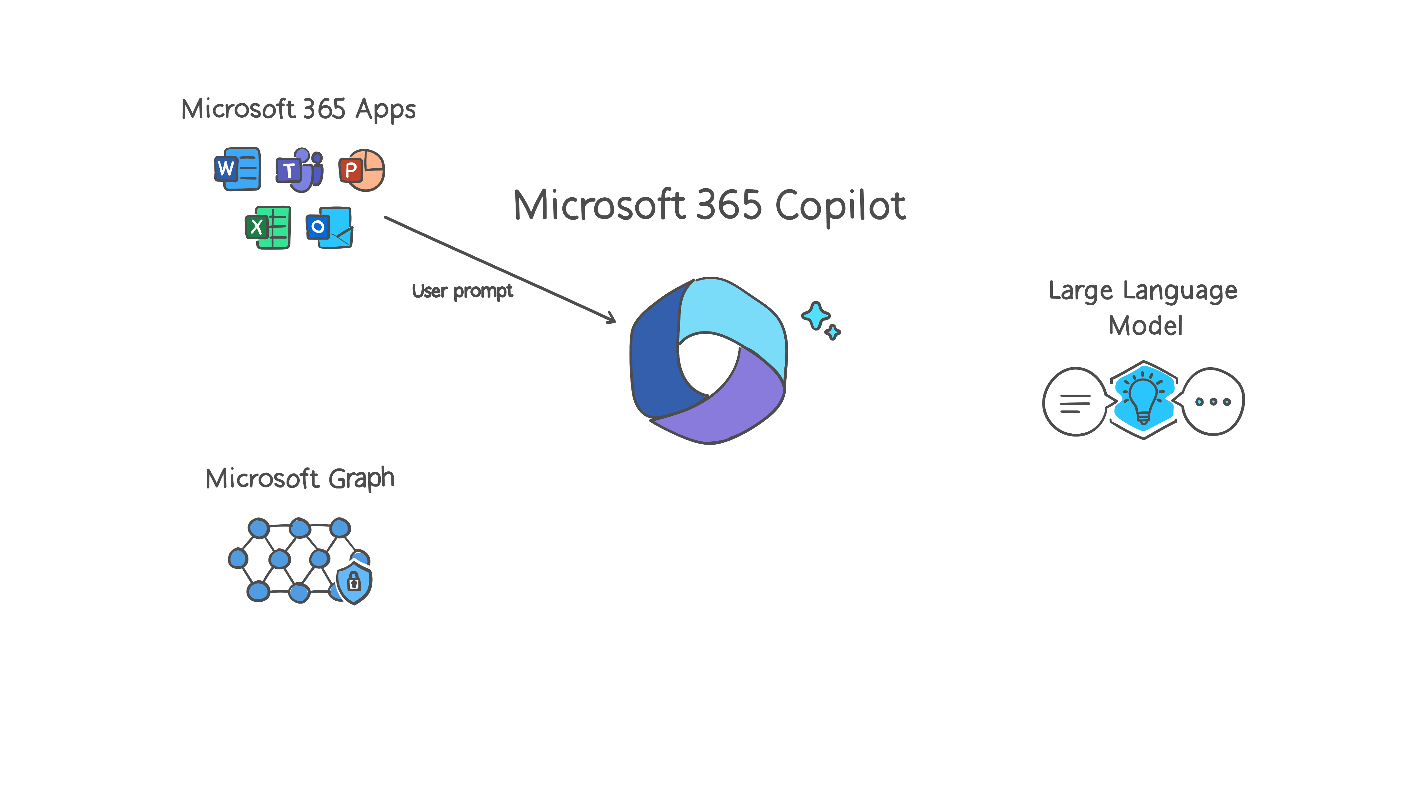
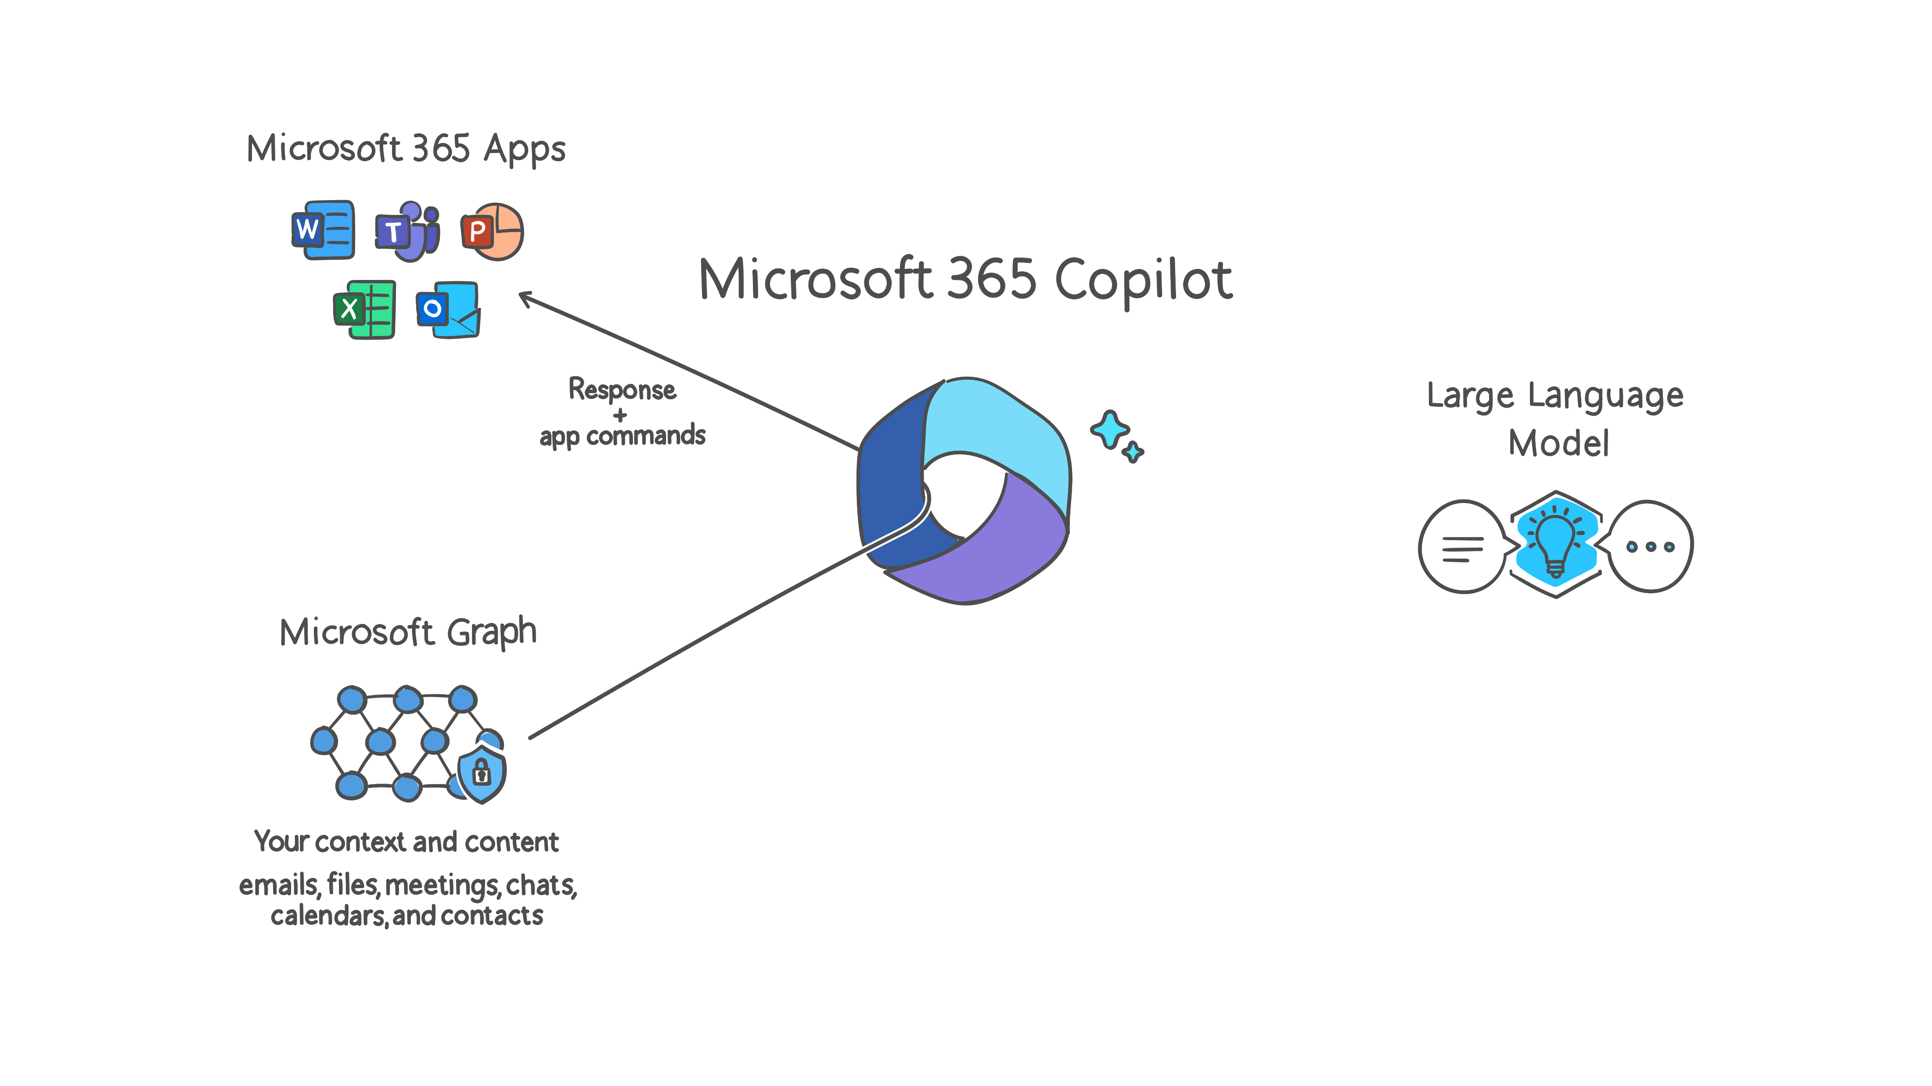

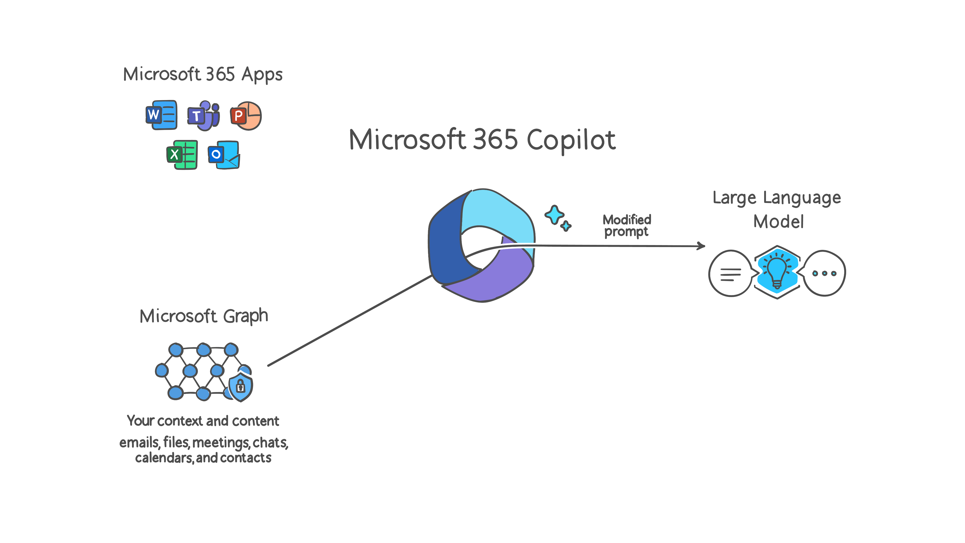
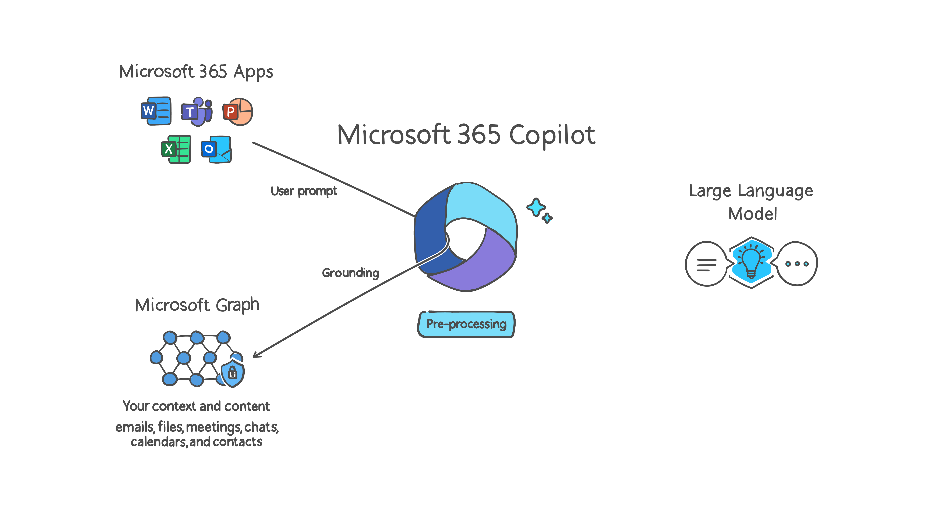
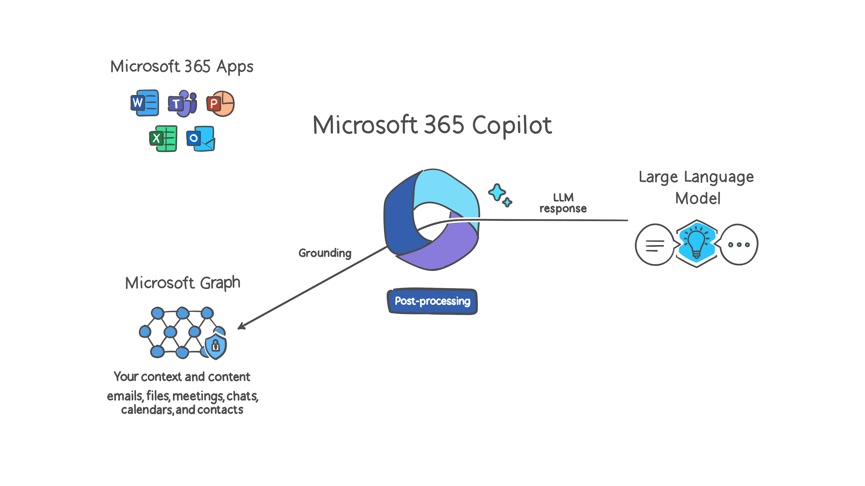
Copilot for Microsoft 365 basic architecture
Microsoft 365 Trust Boundary
Customer data is not stored or used to train the model
Azure Open AI instance is maintained by Microsoft. Open AI has no access to the data or the model.
1
6
Azure OpenAI
3
4
RAI
2
3
RAI is performed on input prompt and output results
Semantic Index
5
Data flow ( = all requests are encrypted via HTTPS)
User prompts from Microsoft 365 Apps are sent to Copilot
Copilot accesses Graph and Semantic Index for pre-processing
Copilot sends modified prompt to Large Language Model
Copilot receives LLM response
Copilot accesses Graph and Semantic Index for post-processing
Copilot sends the response, and app command back to Microsoft 365 Apps
1
2
3
4
Customer Microsoft 365 Tenant
5
6

Slide 12
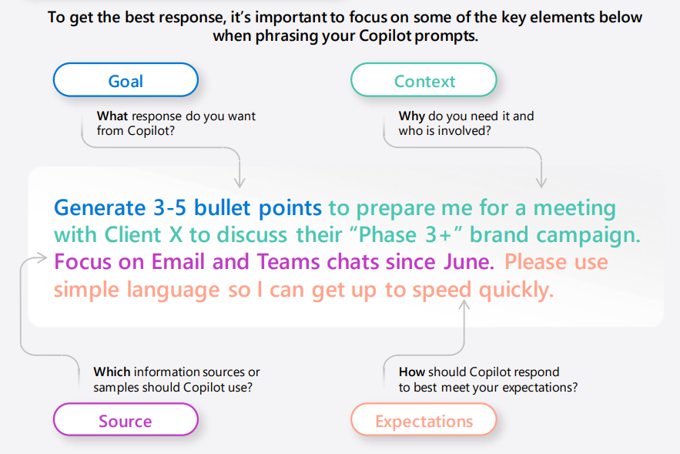
The Art of prompting

Slide 13
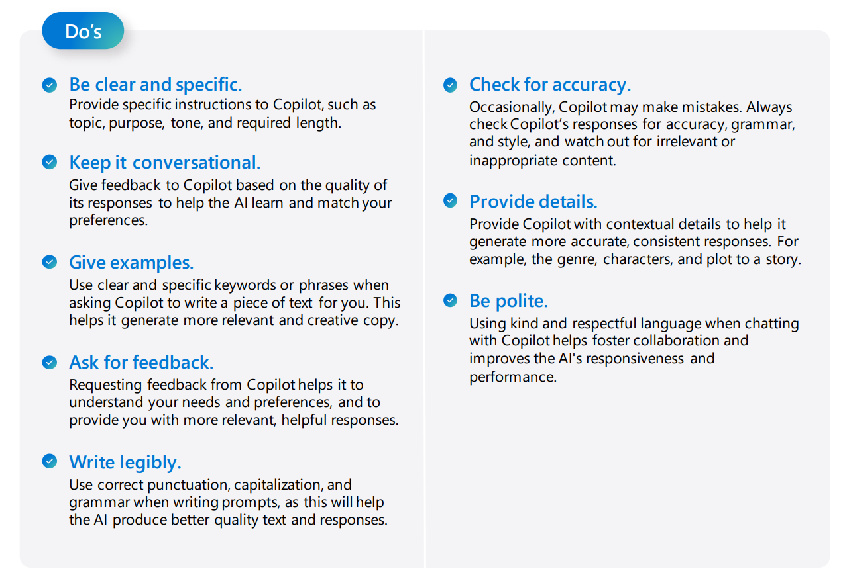
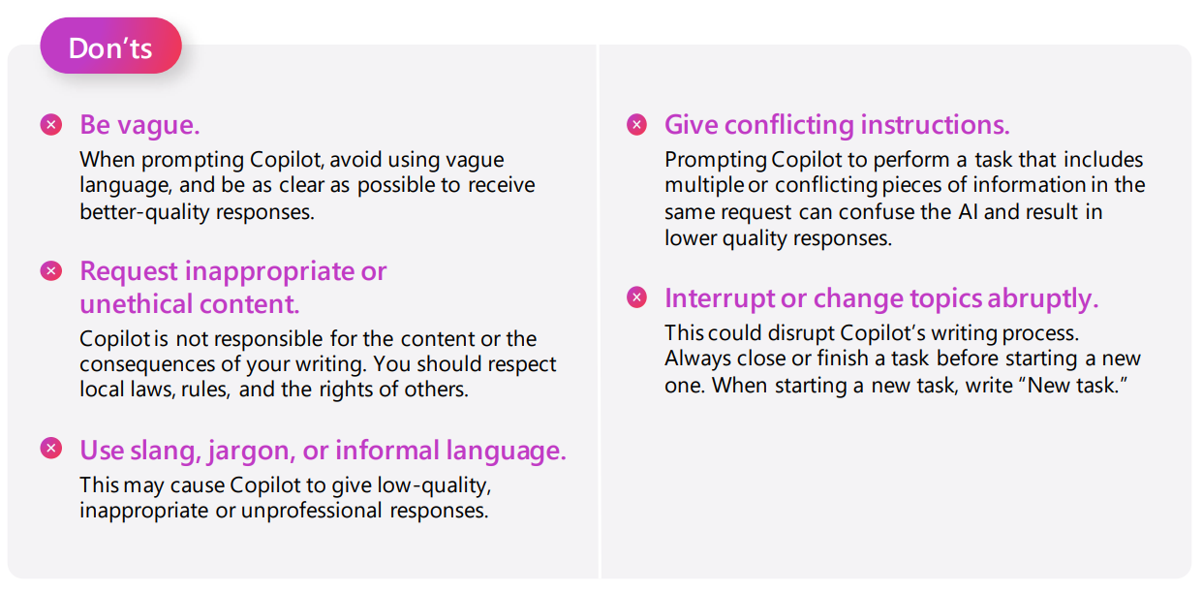
Do’s and Don’t

Slide 14

Demo Microsoft 365 Copilot

Slide 15
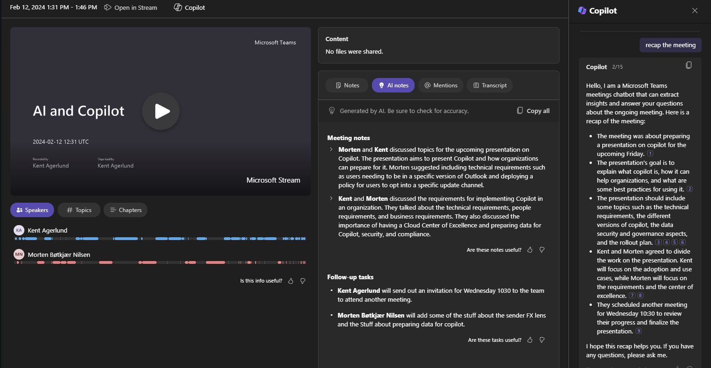
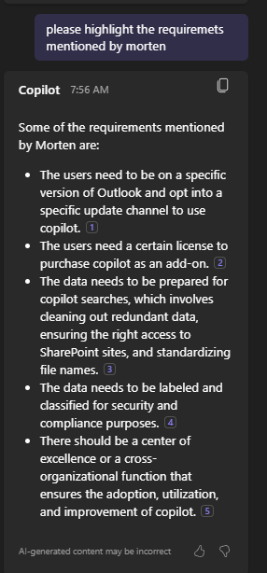
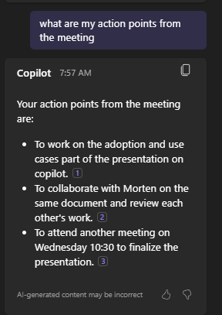
Teams

Slide 16
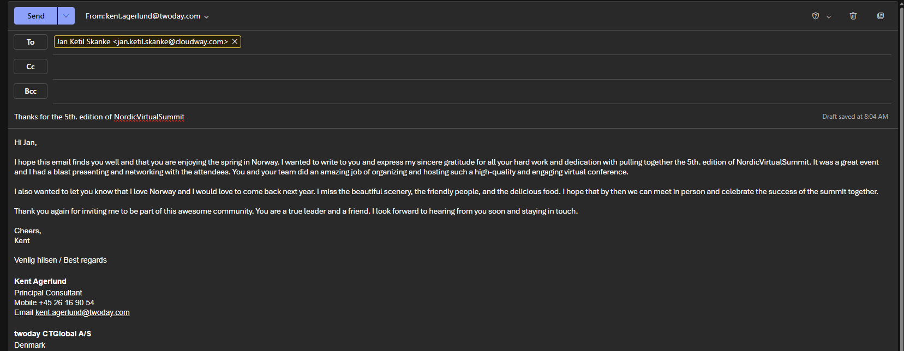
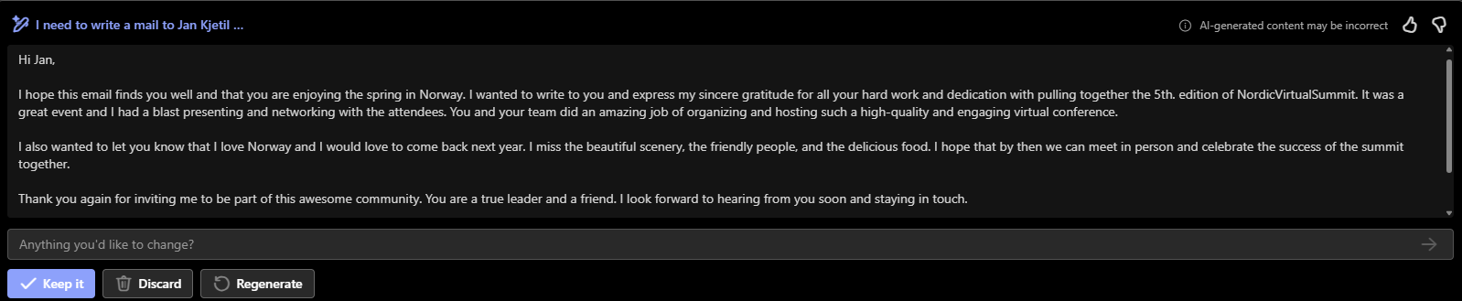
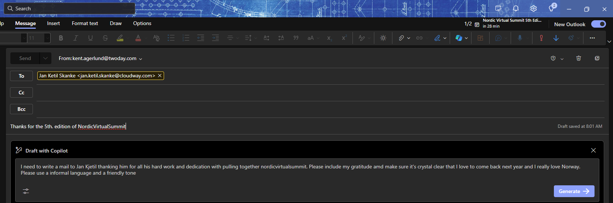
Outlook

Slide 17
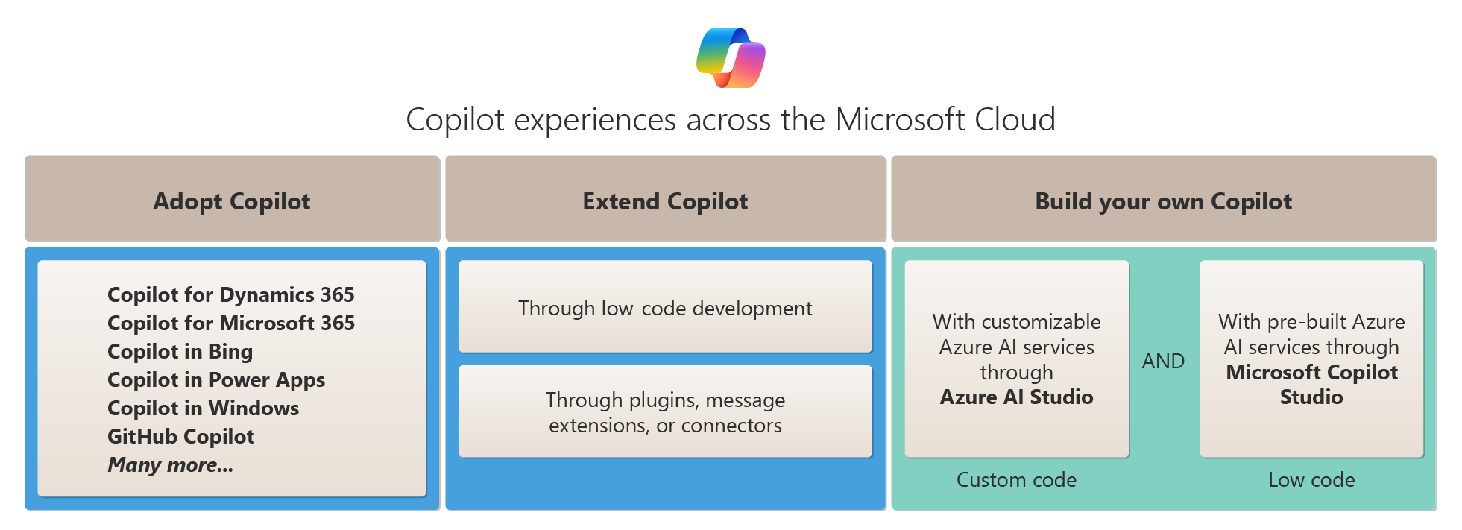
Adopt, Extend, or Build a Copilot

Slide 18
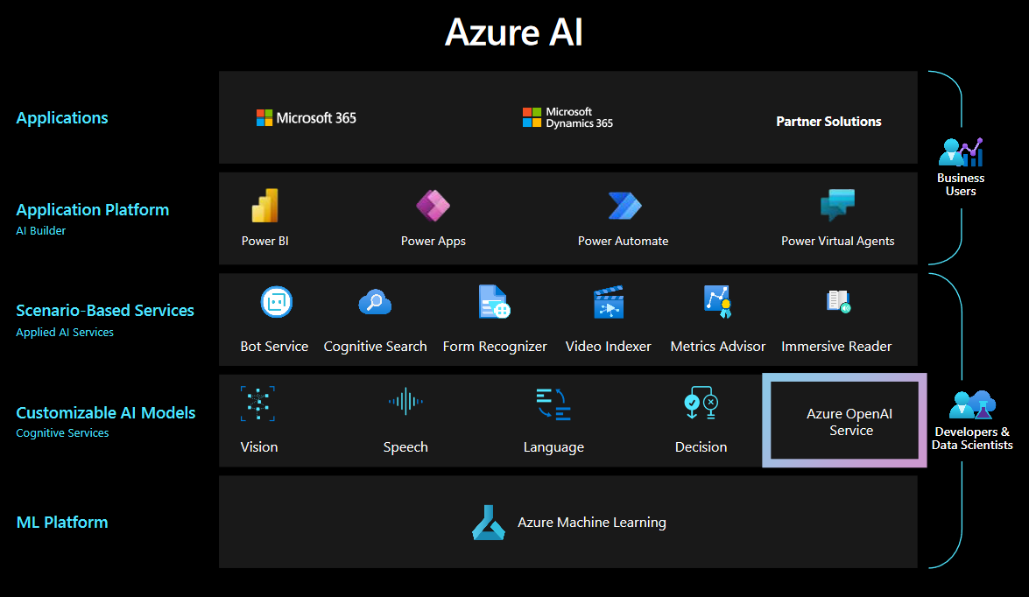

Slide 19
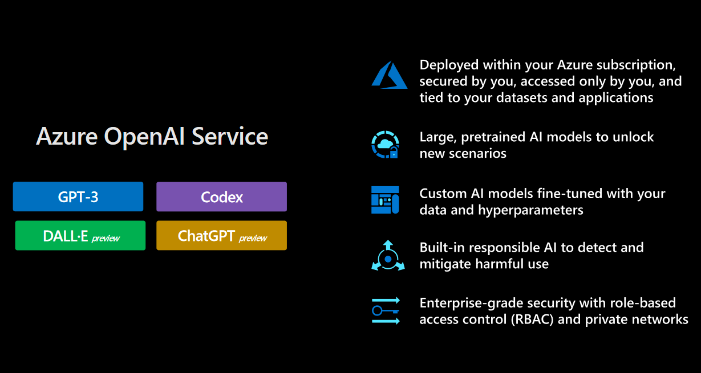

Slide 20









Demo setup
Markdown from Azure DevOps Wiki
Azure blob Storage
Azure AI Search
Azure OpenAI
Azure WebApp
Copilot for MyWiki
Markdown from Git Repos
Cosmos DB

Slide 21
Links
Data security and compliance
Onboarding
Data, Privacy, and Security for Microsoft Copilot for Microsoft 365 | Microsoft Learn
EU Data Boundary
How does Microsoft protect organizational data
Microsoft Compliance | Microsoft Learn
Microsoft Copilot for Microsoft 365 requirements | Microsoft Learn
Enable users for Microsoft Copilot for Microsoft 365 | Microsoft Learn
Copilot Lab (cloud.microsoft)
Microsoft 365 Roadmap | Microsoft 365
Extend Microsoft Copilot for Microsoft 365 | Microsoft Learn
Microsoft 365 admin center Microsoft 365 Copilot usage - Microsoft 365 admin | Microsoft Learn

